Slide 1


AU’2021
Ticket Management System

Slide 2
AU’2021
Mentor
Chandan Chanda
Team
Kunal Sharma
Nayan Narula
Sai Teja Ambari
Govind Singhal

Slide 3
AU’2021
Requirements
Must Have:
Admin:
Ability to view the issues/tickets raised
Ability to create a group and add members to it
Ability to create categories
Ability to associate a category with an user group
User:
Ability to create a ticket on a category
Upload documents during creation/ask-for-details scenarios.
View all the open/closed tickets created by the user
Get notification if group members ask for details.
Receives a notification when the ticket is closed

Slide 4
Requirements
Group Members:
View all the notifications assigned to the group
Receive notification when a ticket is created in a category associated with their group.
Ability to assign the ticket to someone in the group
Ability to close the ticket
Ability to comment on the ticket
Ability to ask details from the creator
Upload documents when the ticket is assigned to their group and it’s not closed.
Common:
Login - Normal/Social Media
Search functionality wherever necessary

Slide 5




AU’2021
Tech Stack

Slide 6
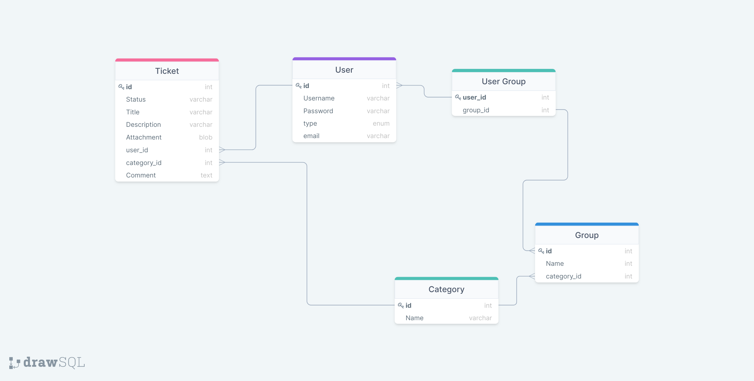
AU’2021
Database

Slide 7
UI SCREENSHOTS

Slide 8
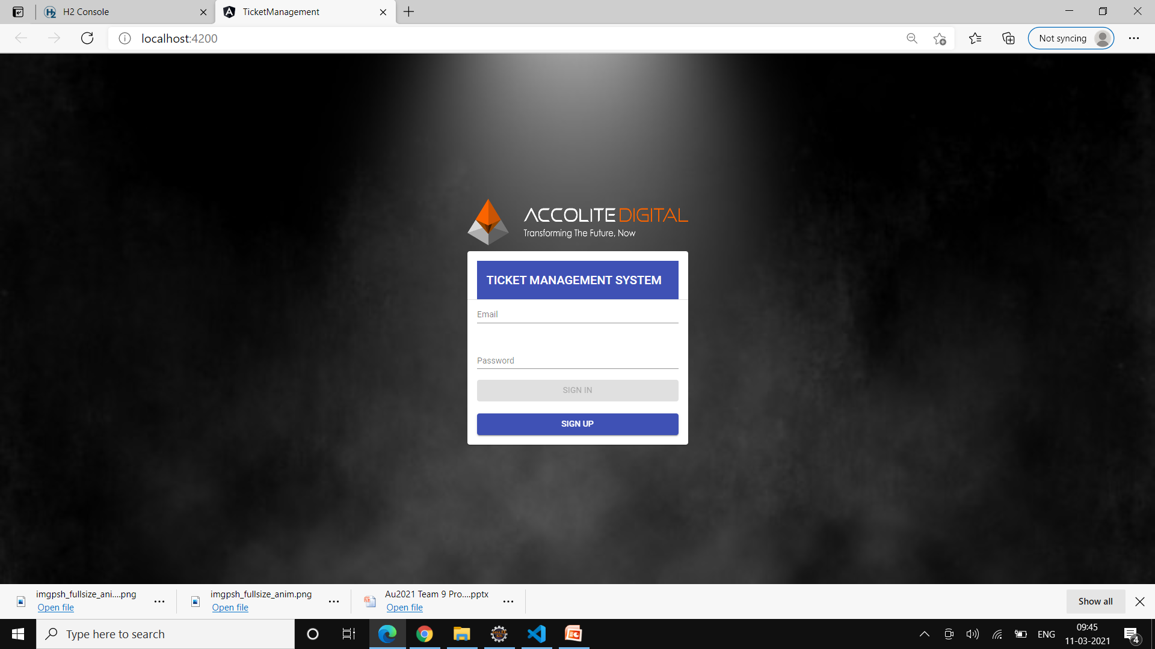
AU’2021
UI Screenshot

Slide 9
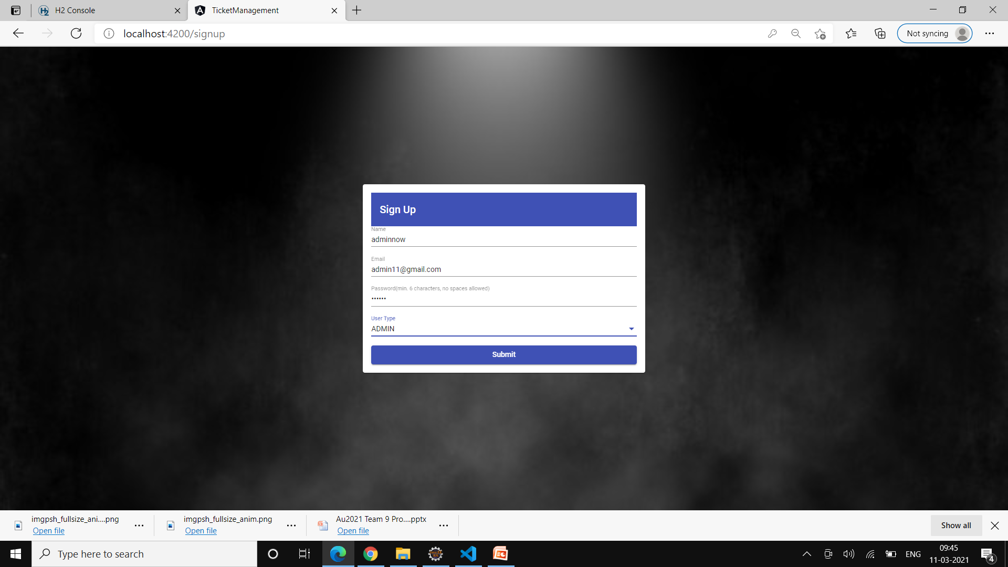

Slide 10
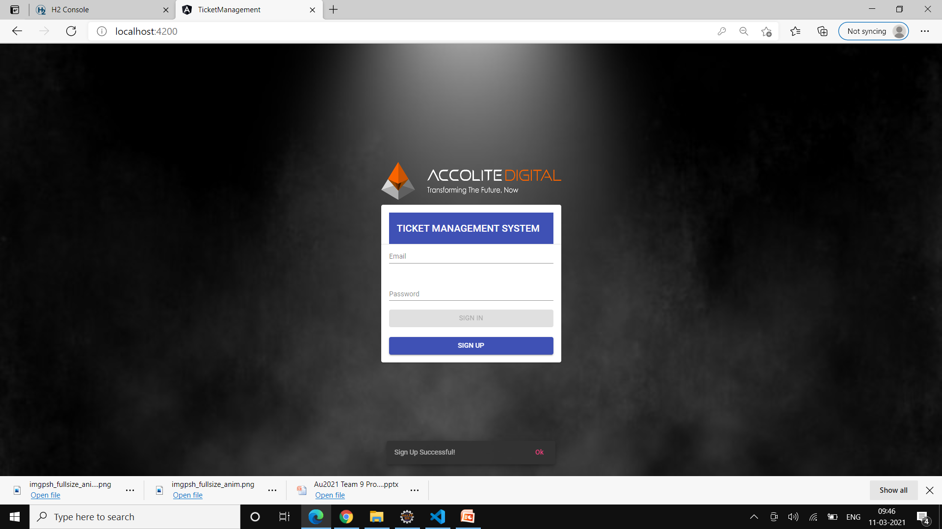

Slide 11
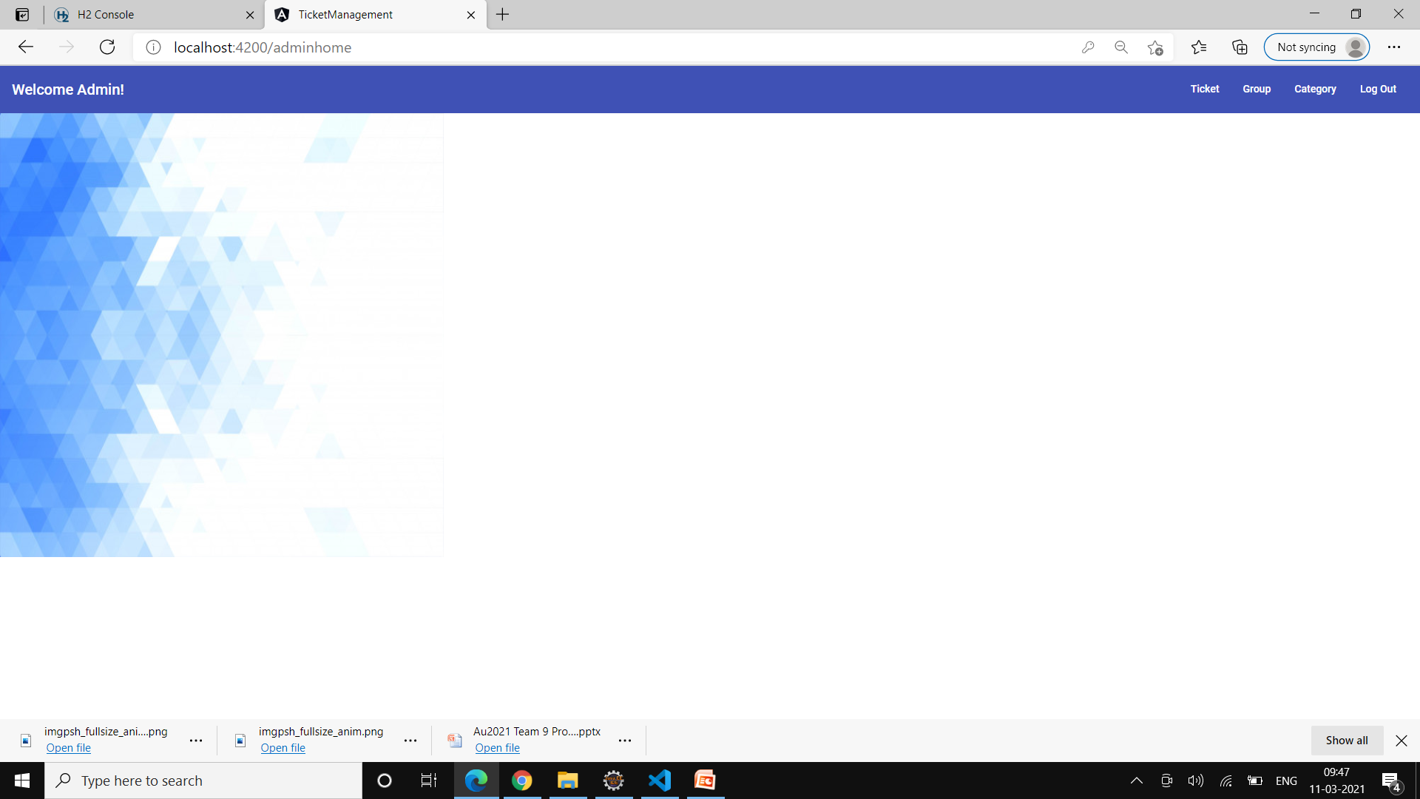

Slide 12
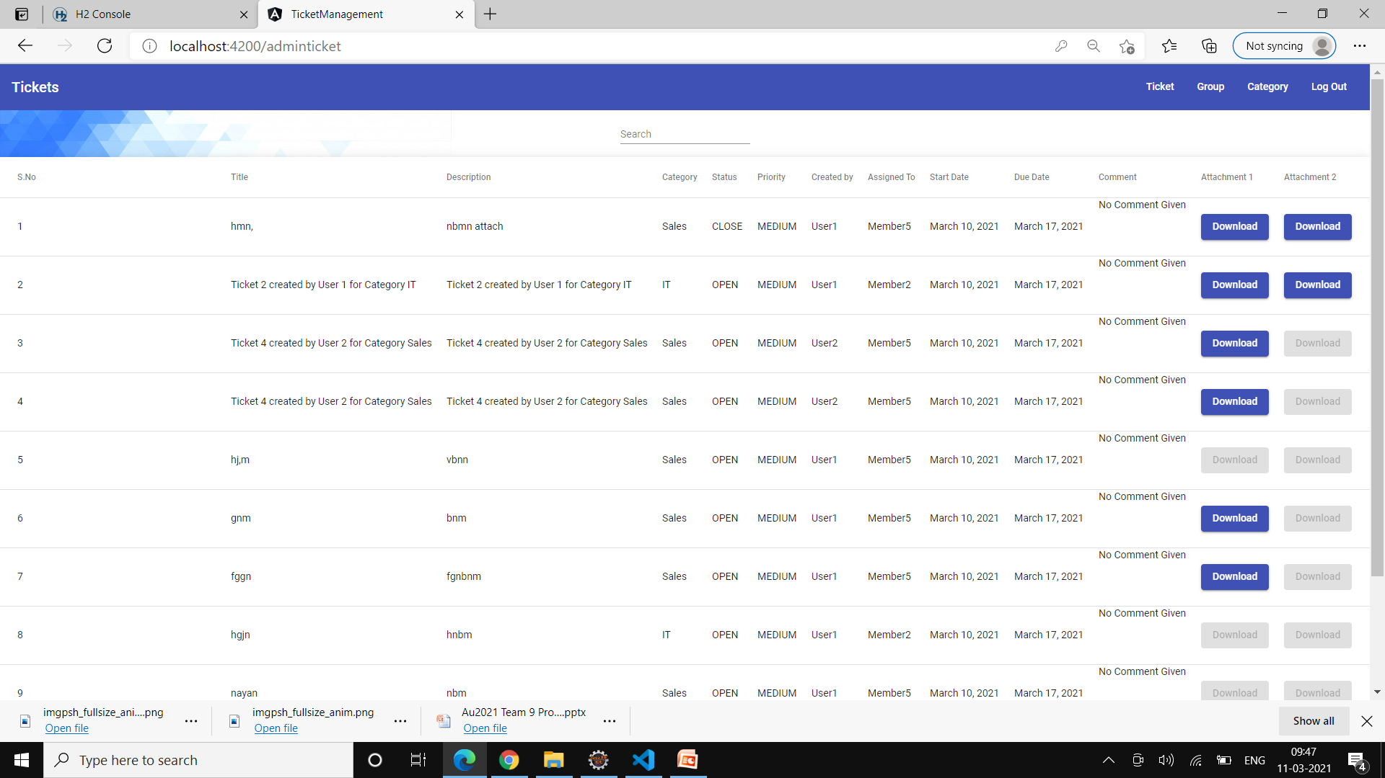

Slide 13
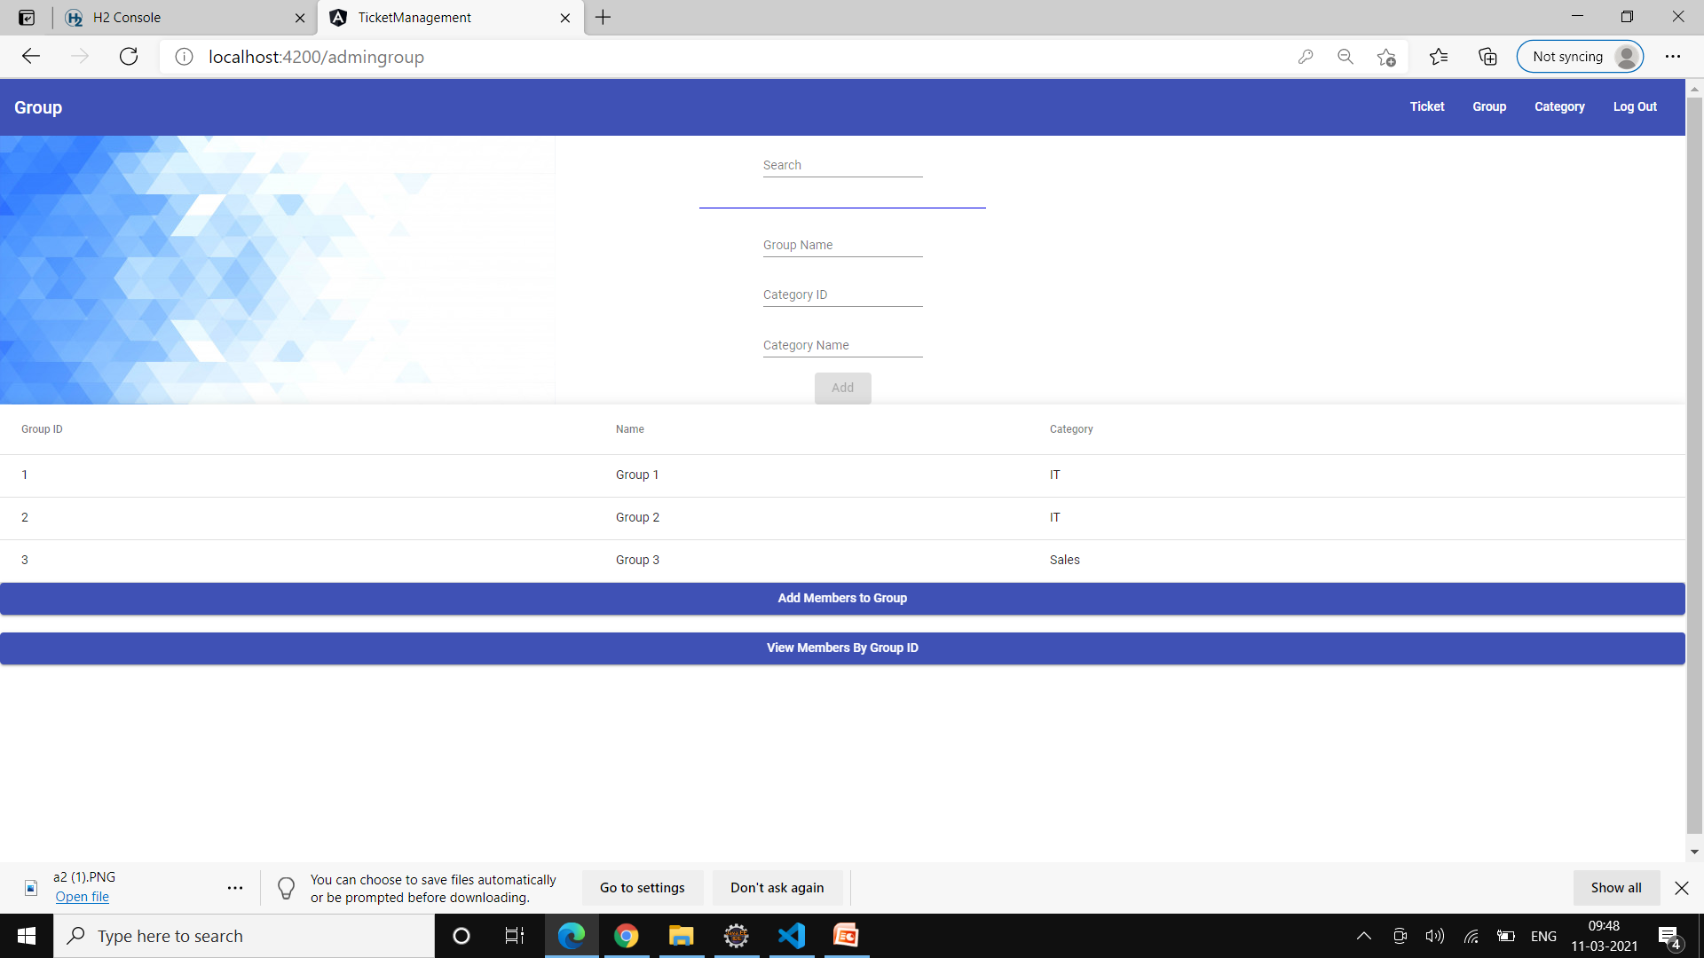

Slide 14


Slide 15
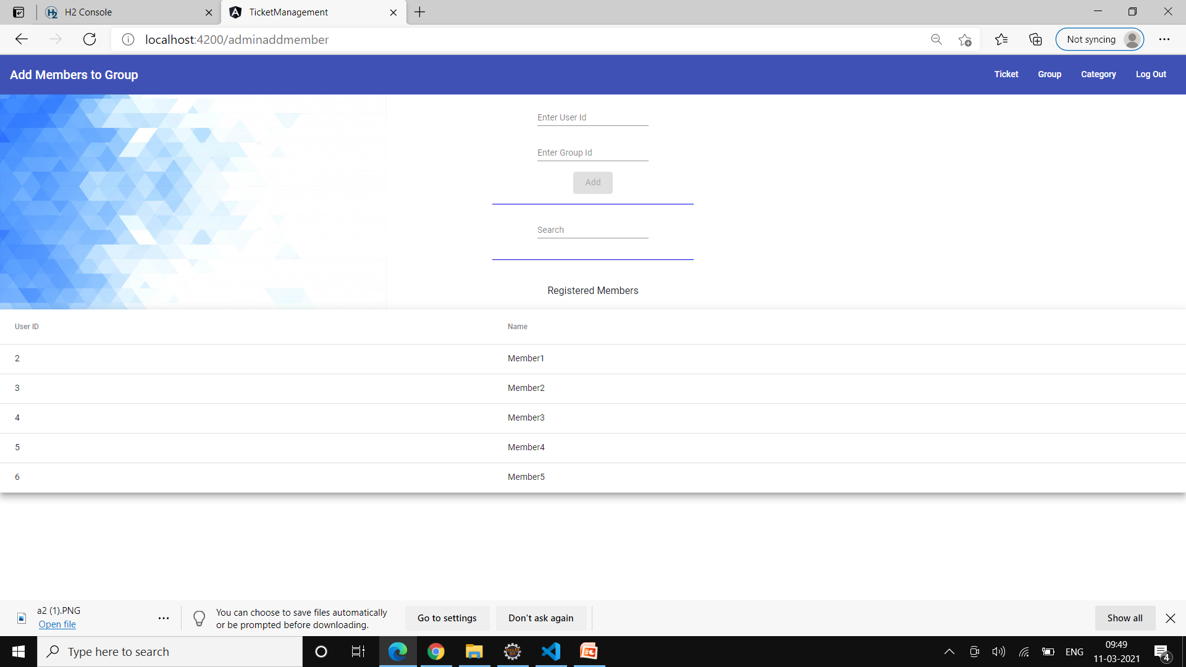

Slide 16
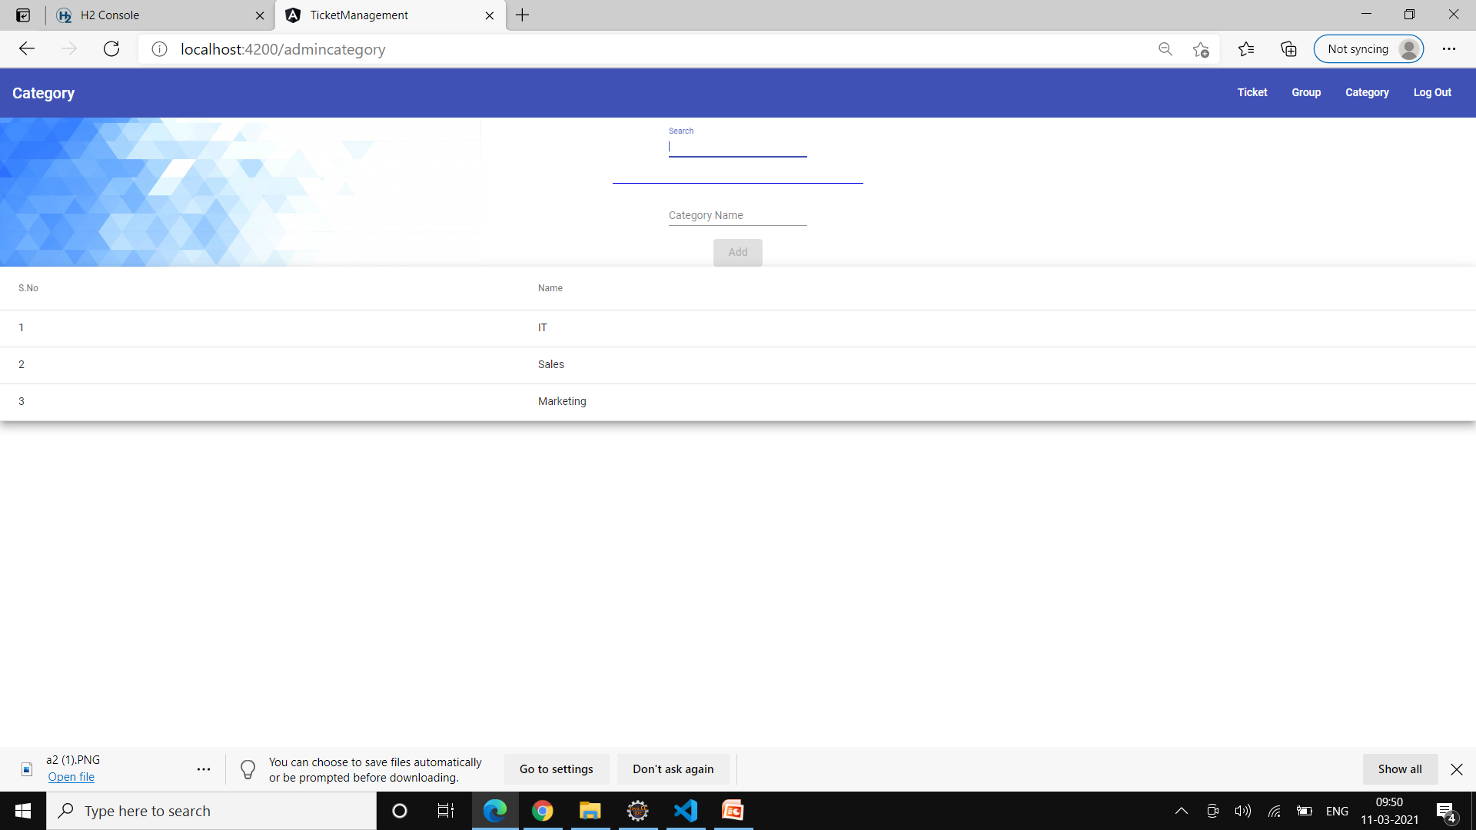

Slide 17


Slide 18
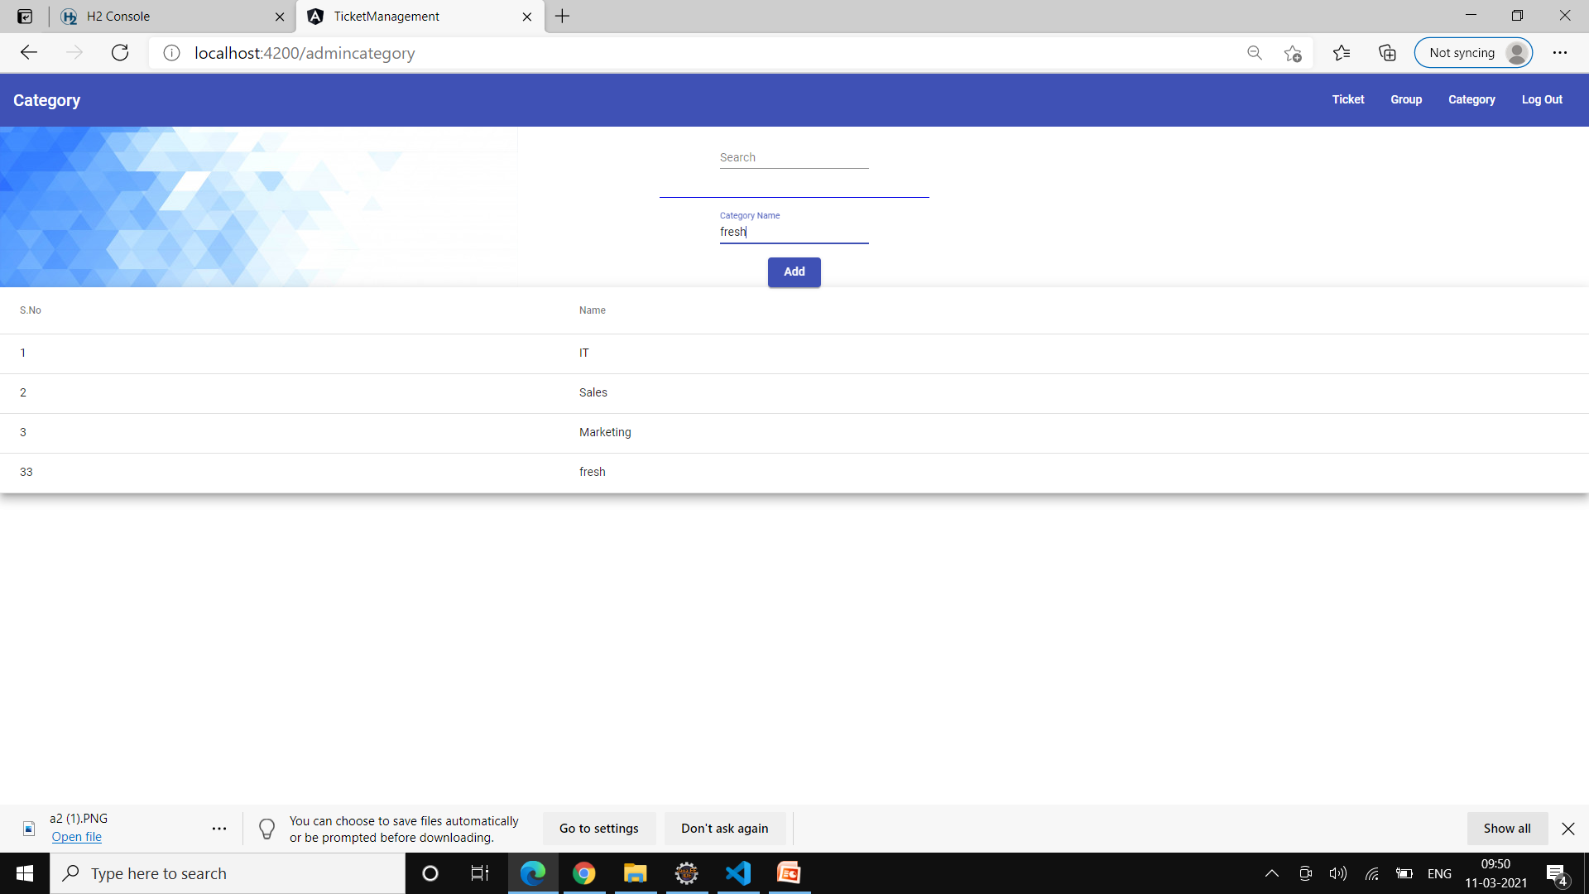

Slide 19
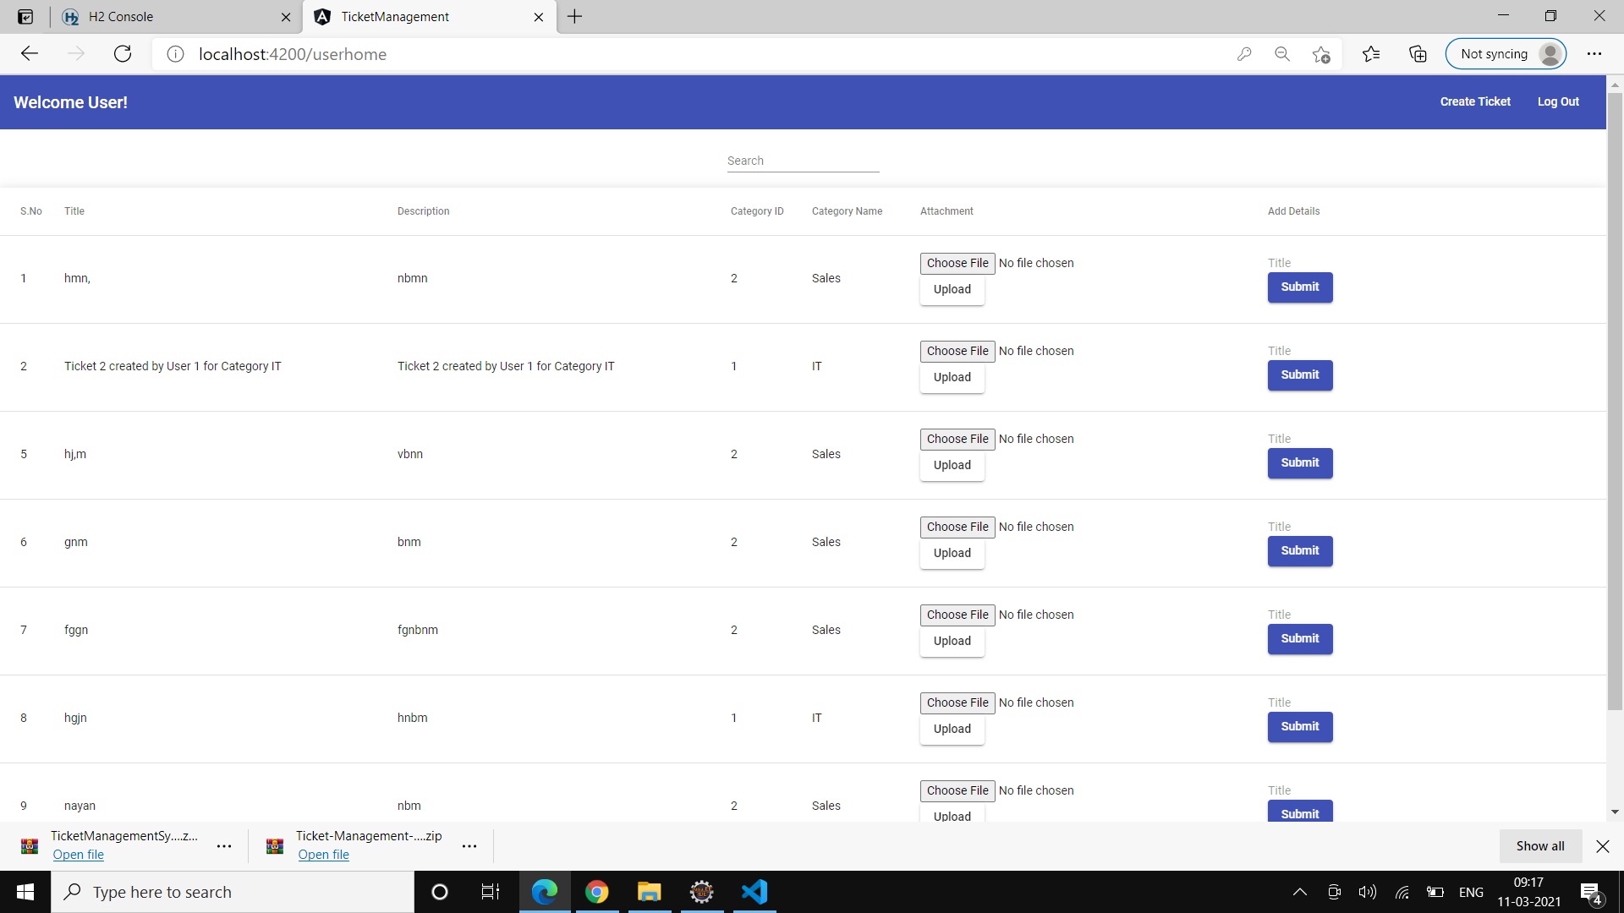
AU’2021
UI Screenshot

Slide 20
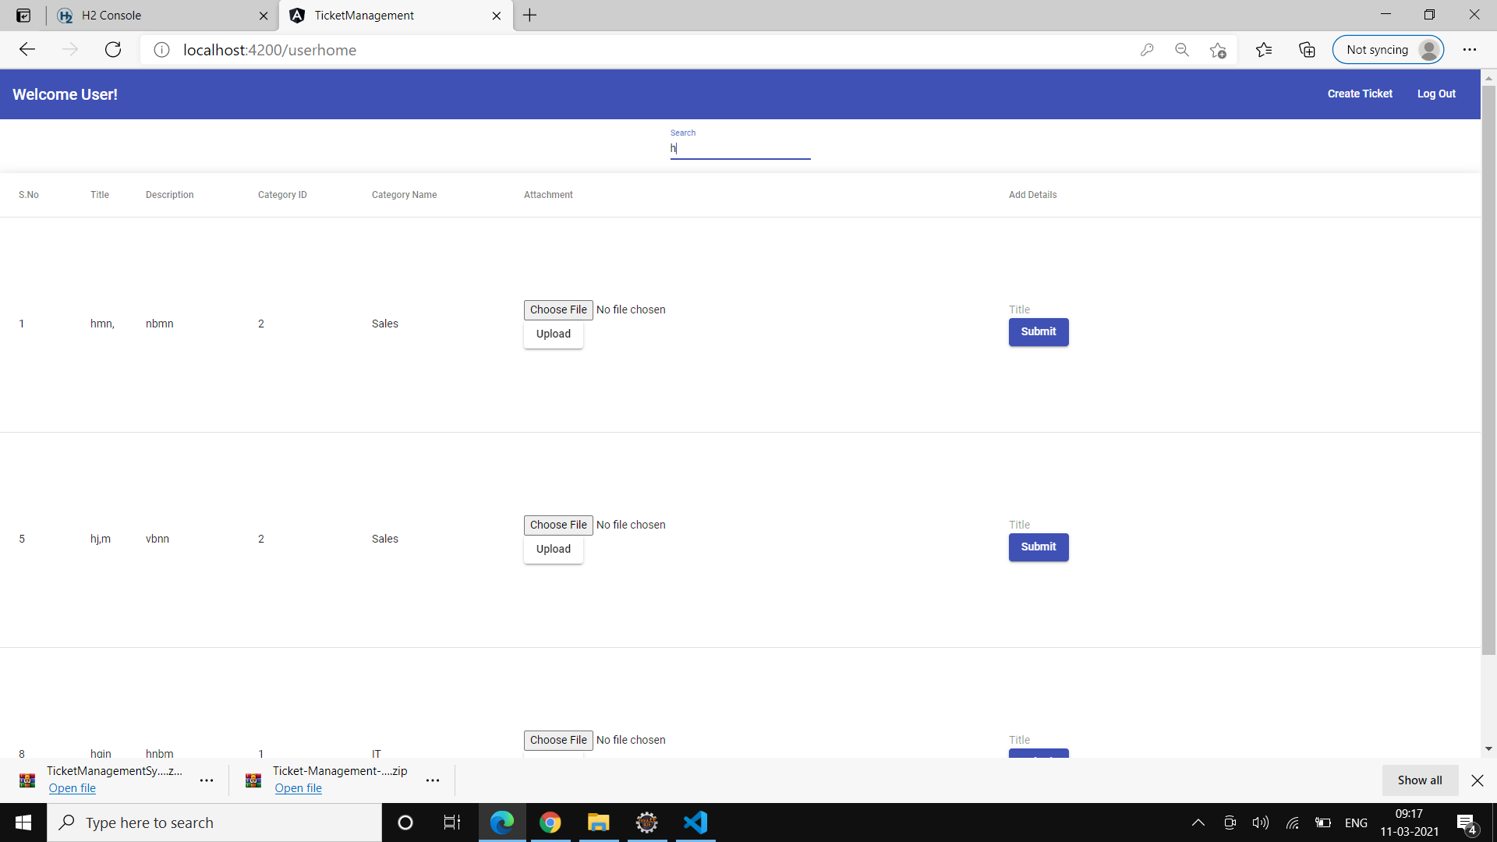

Slide 21
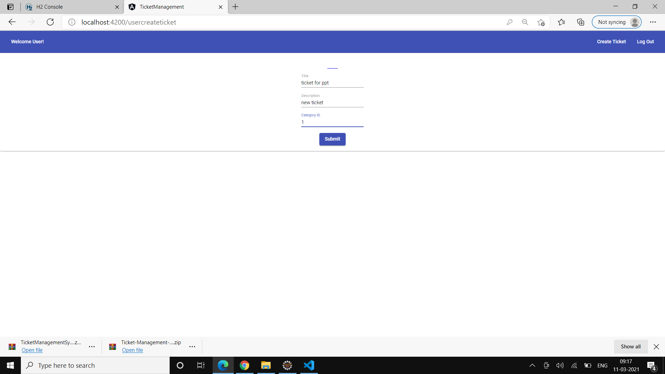

Slide 22
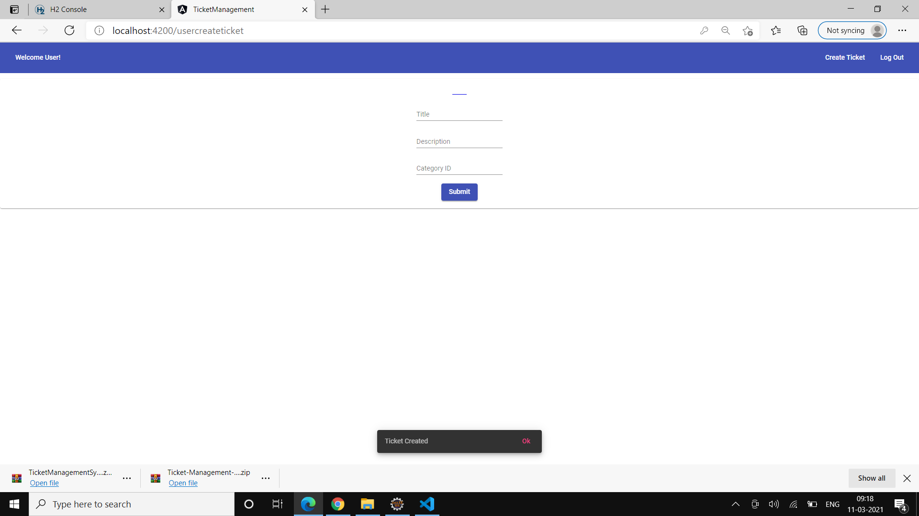

Slide 23


Slide 24


Slide 25


Slide 26
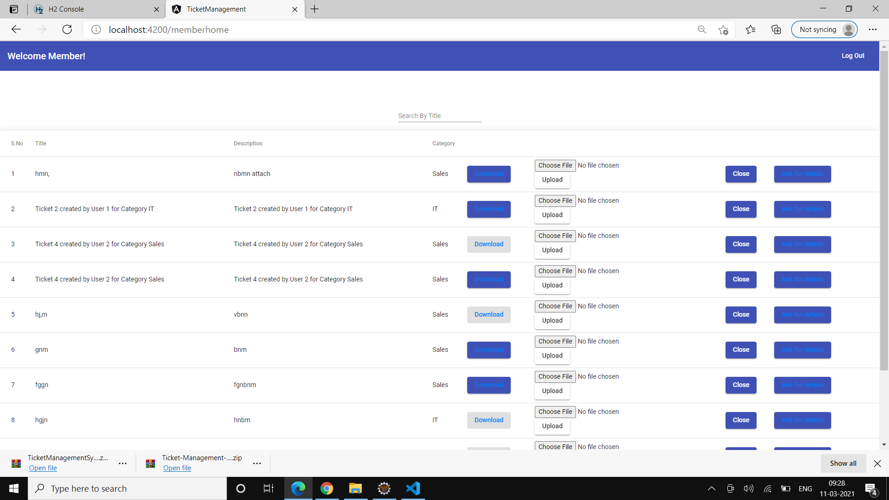

Slide 28
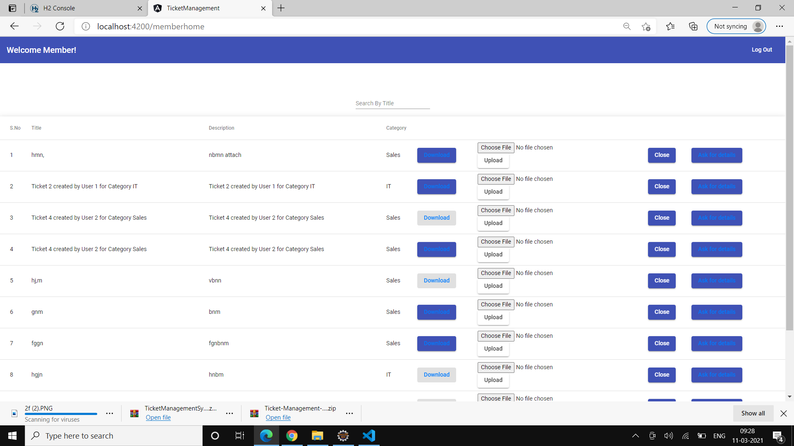

Slide 30


Slide 31
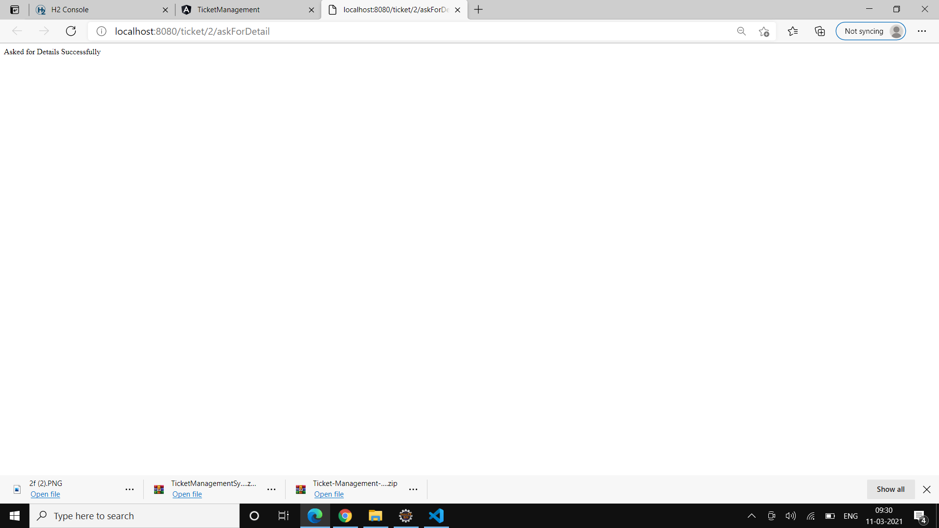

Slide 32
TESTING RESULTS

Slide 33
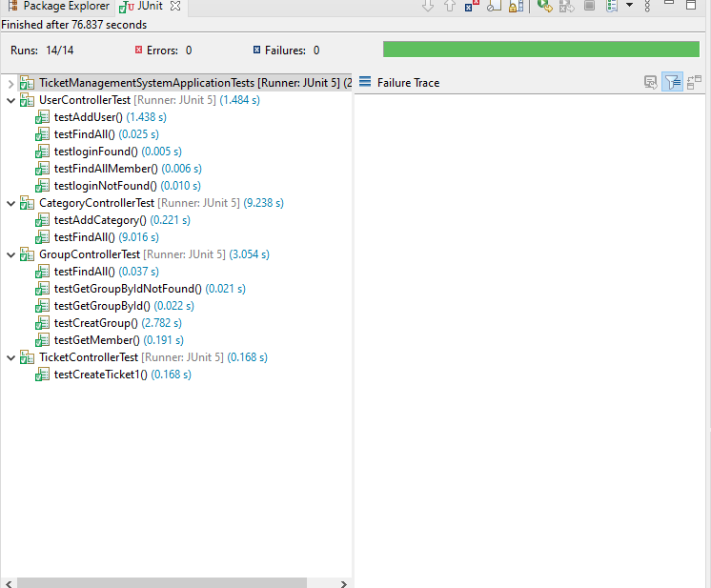

Slide 34
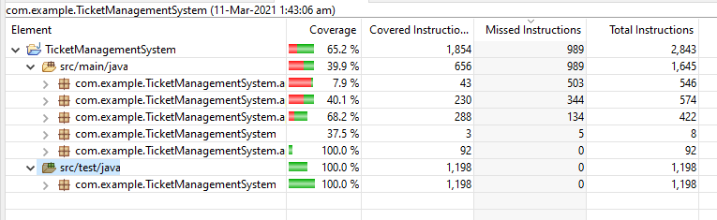

Slide 35
AU’2021
Thank You

